Slide 1
AU ACCESS ACTIVATION & LOG IN
WELCOME TO AUBURN UNIVERSITY

Slide 2
Purpose of this presentation
If you have already activated your AU Access Account successfully, you may disregard this PowerPoint.
Assist international students with their AU Access activation and log in

Slide 3
Let’s ACTIVATE your AU Access

Slide 4
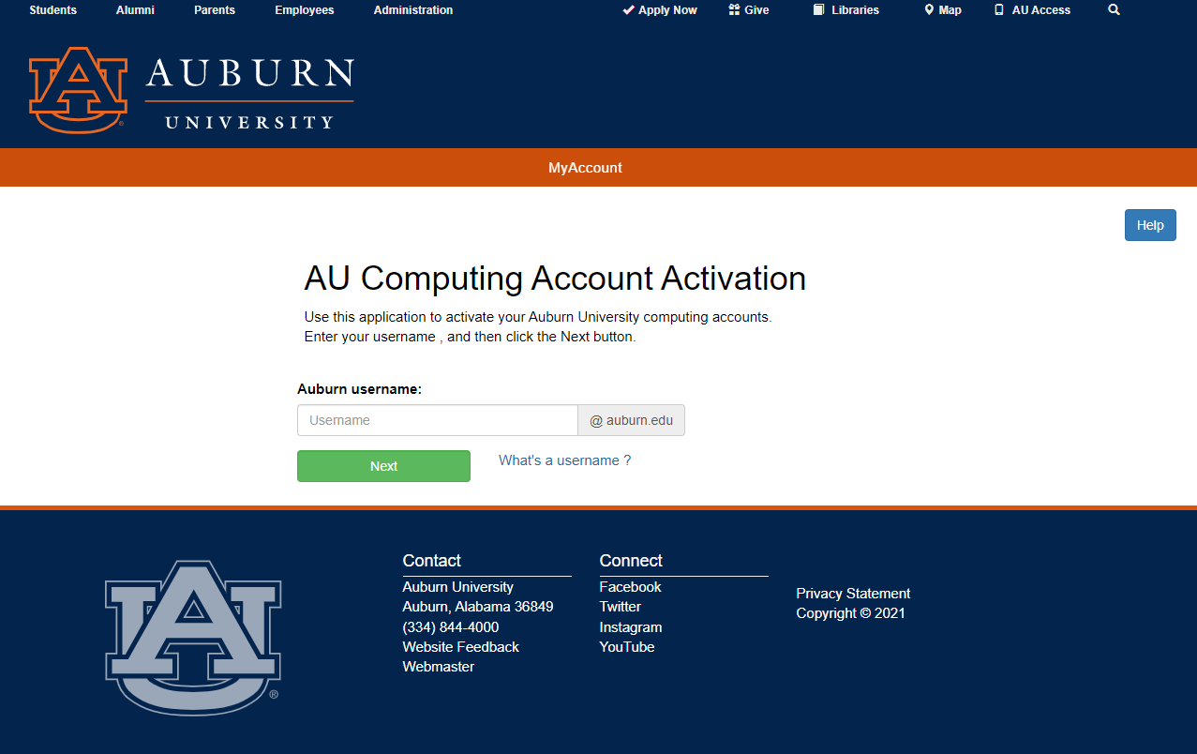
7 steps to activate your AU Access
STEP 1
To activate your AU Access visit www.auburn.edu/activate
Your username is written on your acceptance letter and is also known as your GID. It consists of 3 letters and 4 digits, e.g. kzp0049.

Slide 5
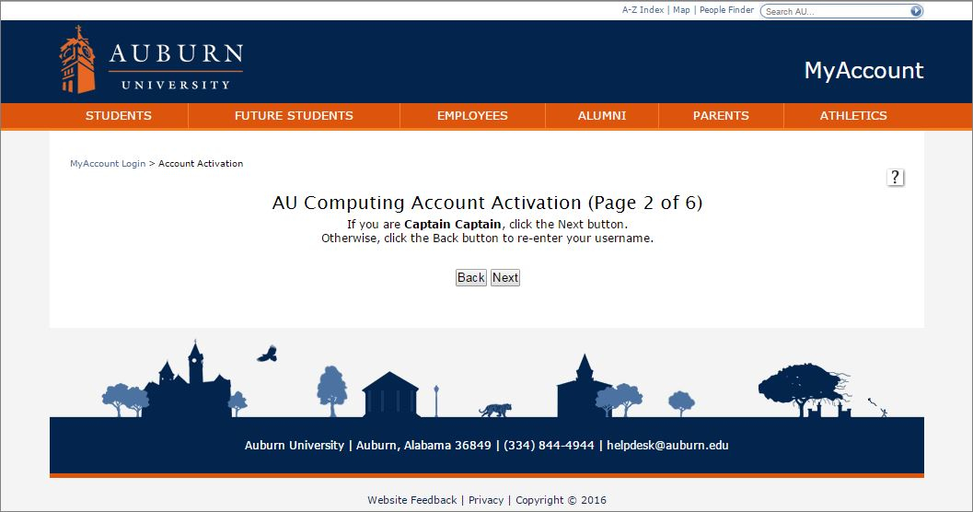
7 steps to activate your AU Access
STEP 1
STEP 2
Verify and confirm your identity to continue.
If it is not you, click “Back” to return to the previous page and verify your username is correctly entered.

Slide 6
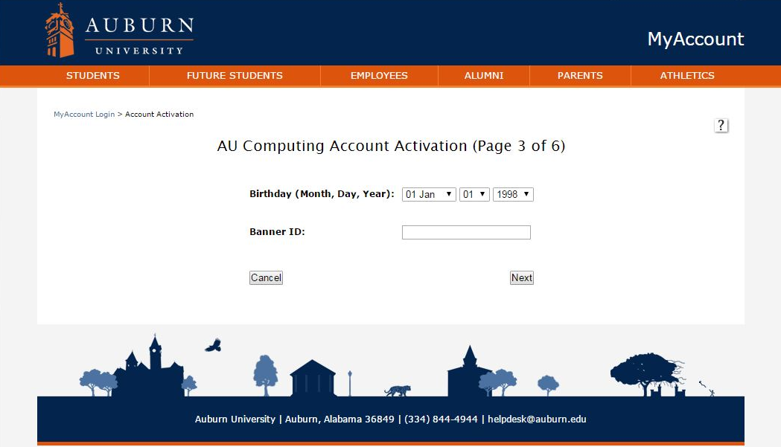
7 steps to activate your AU Access
STEP 1
STEP 2
STEP 3
Enter the required information to validate your identity
Your Banner ID is written on your acceptance letter and contains a 9-digit number, e.g. 903XXXXXX.
If you experience technical difficulties, please call the IT Help Desk at (334) 844-4944 and let them fix your account.

Slide 7
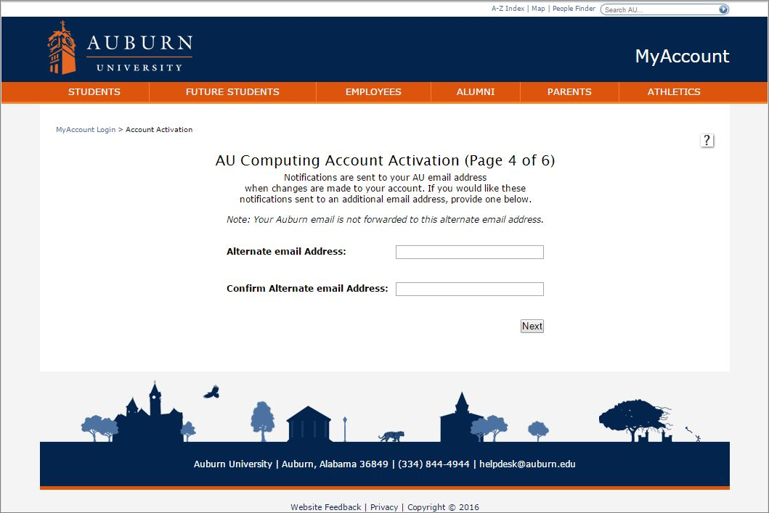
7 steps to activate your AU Access
STEP 1
STEP 2
STEP 3
STEP 4
Enter and confirm your personal email address as an alternate email address

Slide 8
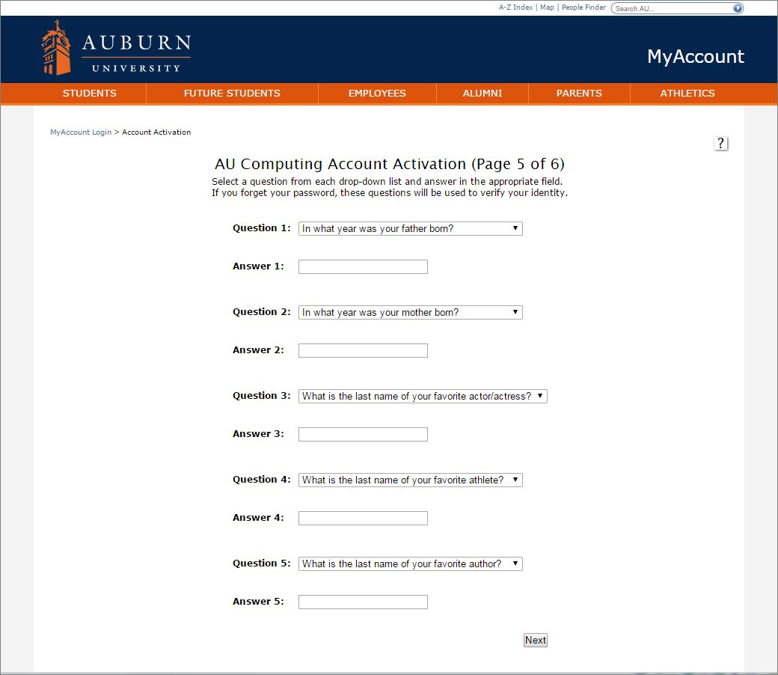
7 steps to activate your AU Access
STEP 1
STEP 2
STEP 3
STEP 4
STEP 5
Set up your personal and confidential security questions. They will be used to verify your identity if you need to reset your account’s credentials.
We recommend that you keep a record of your questions and answers in case you forget.

Slide 9
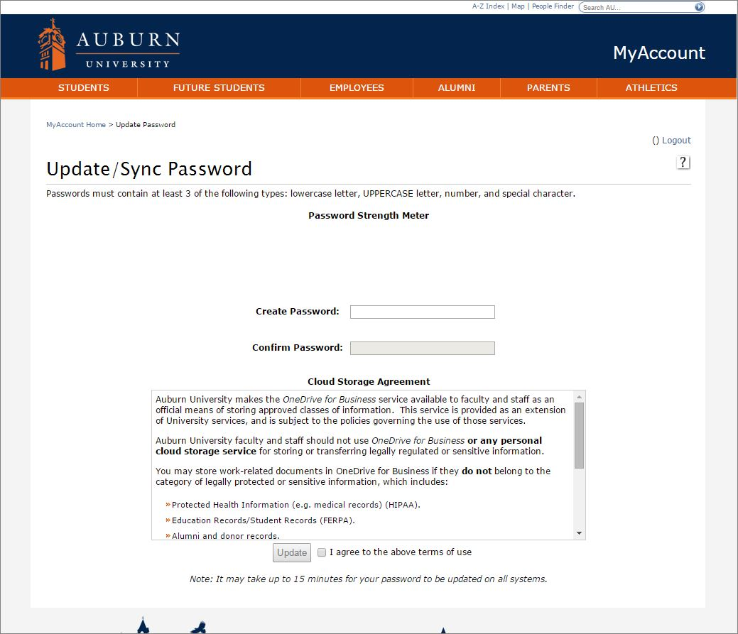
7 steps to activate your AU Access
STEP 1
STEP 2
STEP 3
STEP 4
STEP 5
STEP 6
Set up your personal and confidential AU Access password
Be Aware of password rules
Password must be 8 (min) to 16 (max) characters
and must start with a letter.
In addition, it must meet at least 3 of the following requirements:
An UPPERCASE letter (ABCDEFGHIJKLMNOPQRSTUVWXYZ)
A lowercase letter (abcdefghijklmnopqrstuvwxyz)
A number (0123456789)
A special character
(! @ # $ % ^ & * - _ + = [ ] { } | \ : ' , . ? / ` ~ " < > ( ))

Slide 10
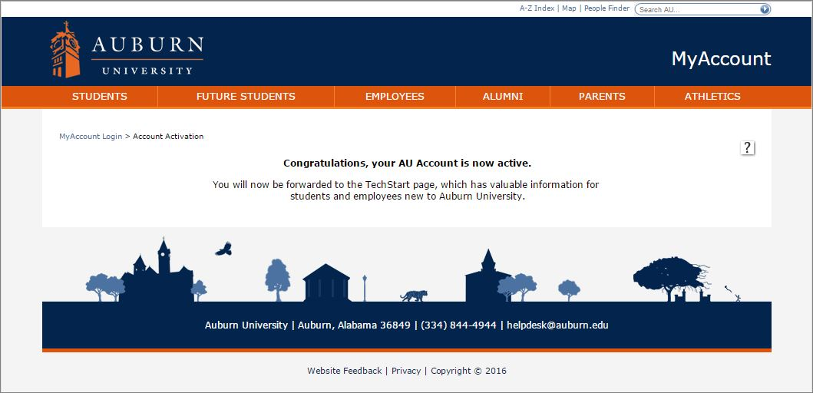
7 steps to activate your AU Access
STEP 1
STEP 2
STEP 3
STEP 4
STEP 5
STEP 6
STEP 7
Your AU Access account has successfully been activated

Slide 11
Let’s LOG IN to your AU Access

Slide 12
3 steps to log in to your AU Access
STEP 1
Visit www.auburn.edu and click on
“AU Access” located at the right
top corner in the menu

Slide 13
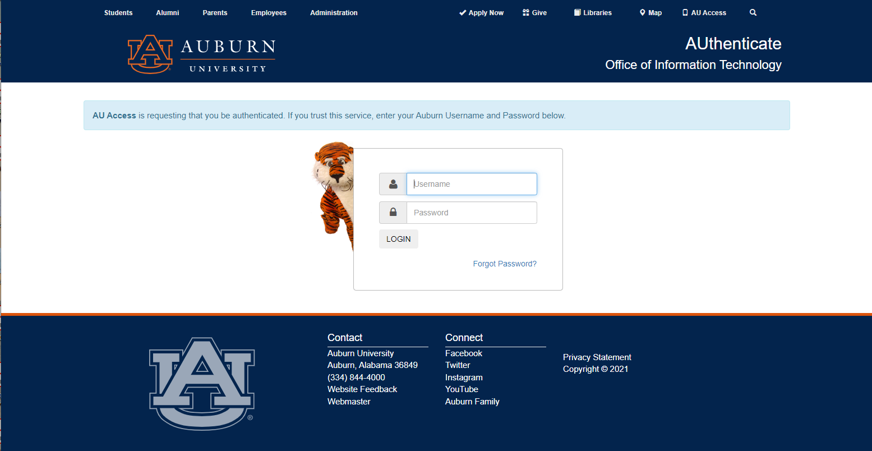
3 steps to log in to your AU Access
STEP 1
STEP 2
Log in with your personal and confidential AU Access credentials created earlier

Slide 14
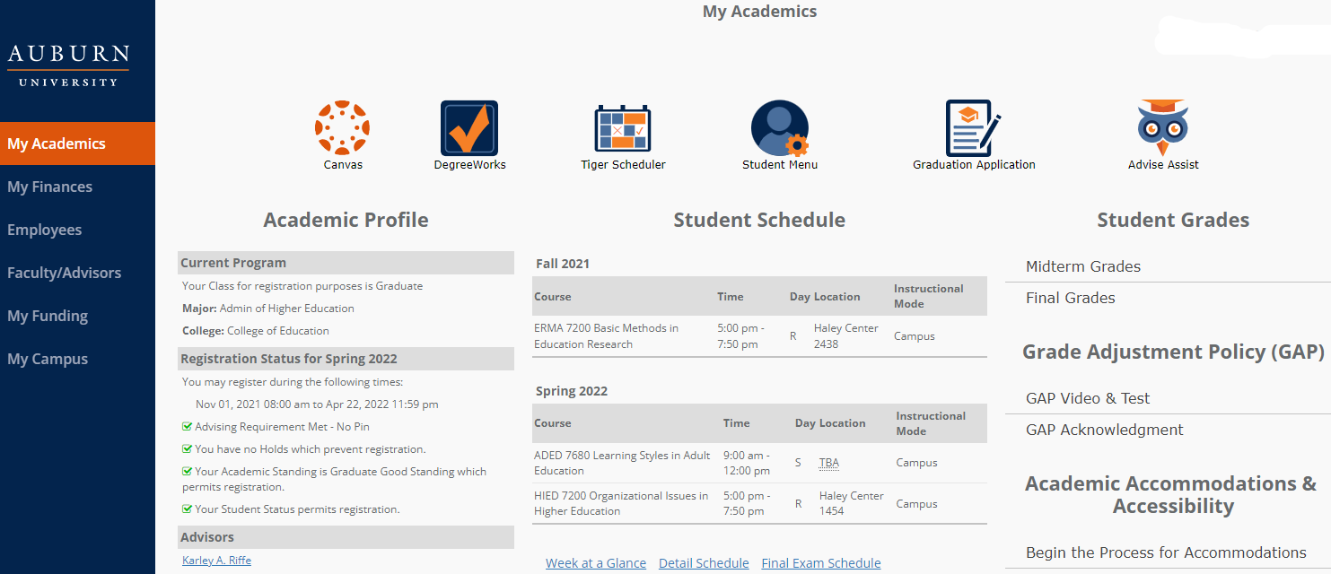
3 steps to log in to your AU Access
STEP 1
STEP 2
STEP 3
Congratulations,
your AU Access account is now all set!
Be aware
Should you need to reset your password visit this website https://oitapps.auburn.edu/myaccount/
Most students are able to activate their AU Account (also known as Tiger account) overseas.
If you are still experiencing technical issues after seeking help with OIT Help Desk, do not worry, we will get your account fixed once you arrive on campus.
Please be aware of our online check-in reservation event. The link for reservation will be/has been sent to you.

Slide 15
228 Foy Hall
Auburn University
Auburn, AL 36849
(334) 844-5001
intledu@auburn.edu
@AUIntlPrograms

